Slide 1
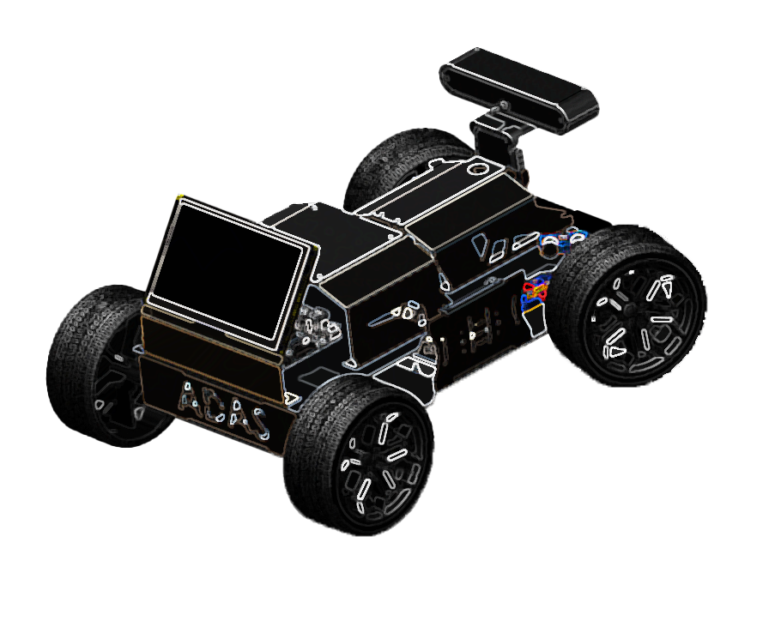


Slide 2
TEAM Members
Hatem Abdelhamid
Haneen Salah
Abdelrahman Amr
Abdelrahman Mohamed
Mahmoud Mohamed
Fesal Mohamed
Ahmed Mohamed
Toka Hamdy
Youssef Mohamed
Omar Hosny
Supervised By:
Dr. Waleed Abd-Elshafi Ali Elshazly.

Slide 3
Outline
Introduction
Conclusion
Bump Detection
Car Movement
Blind Spot detection
Lane Departure
Adaptive cruise control
Traffic sign Recognition

Slide 4
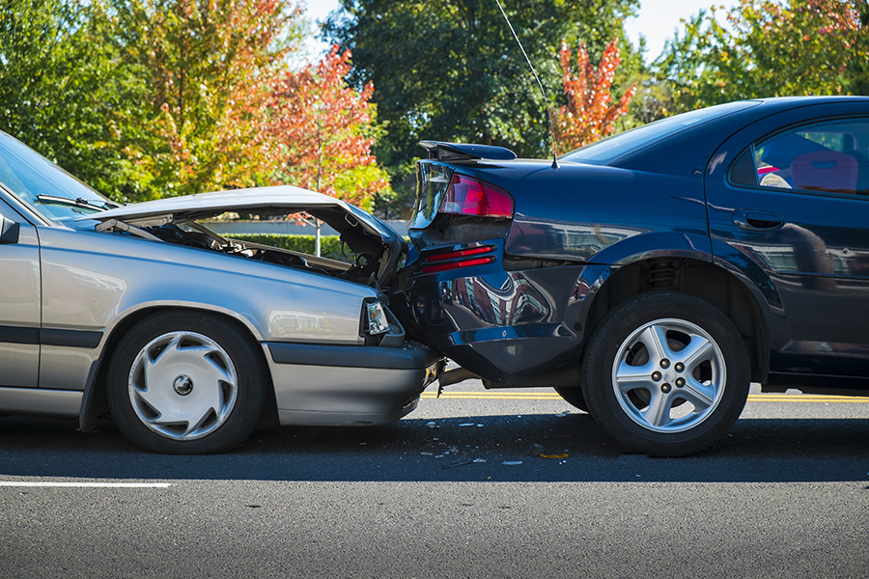

Problem statement
A driver is one of the “best sensors in the vehicle” and is primarily responsible for avoiding crashes. But still, a large proportion of crashes are attributed to driver errors. These errors included recognition, decision, performance, and nonperformance errors. These errors are predominantly due to misjudgments of the driver, poor directional control, inattention, sleeping, and fatigue.

Slide 5
Statistics in 2022
55,991
8.7%
7,101
Crashes resulted in injuries
Increased compared to the previous year
Fatal car accidents

Slide 6
Problem statement
A driver is one of the “best sensors in the vehicle” and is primarily responsible for avoiding crashes. But still, a large proportion of crashes are attributed to driver errors. These errors included recognition, decision, performance, and nonperformance errors. These errors are predominantly due to misjudgments of the driver, poor directional control, inattention, sleeping, and fatigue.

Slide 7
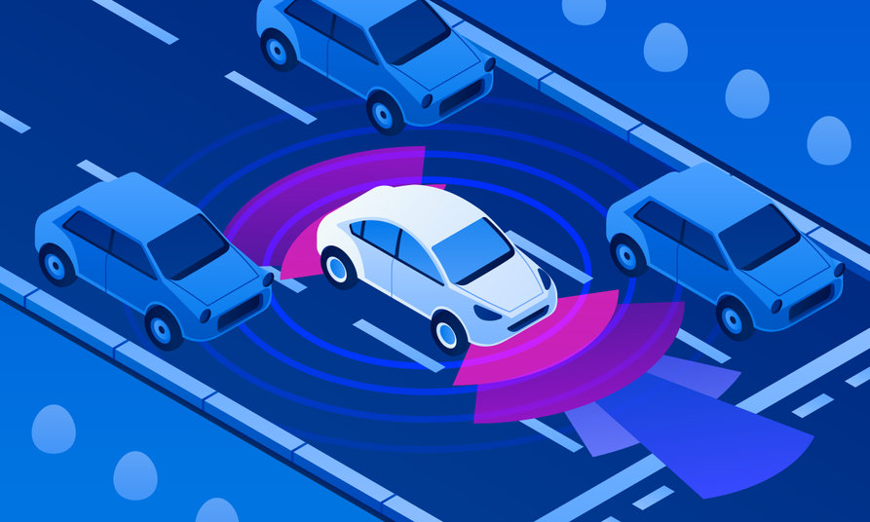

Project Objectives
ADAS can work an important role in many factors to reduce the number of these cases as possible using the power of sensors and Machine learning algorithms to analyze the environment around the vehicle and take the required action in the suitable time , these factors are:
Blind Spot Detection System.
Lane Departure.
Adaptive Cruise Control.
Bump Detection.
Traffic Sign Recognition.

Slide 8
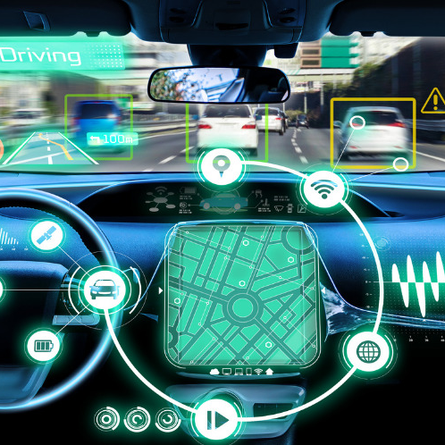
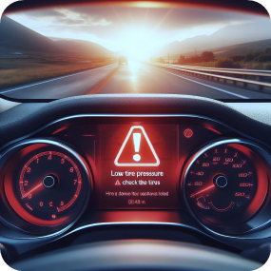

Project Objectives cont.
Safety
Alerts
Assistance
Ensure the safety of occupants and pedestrians
Provide real-time alerts and warnings for potential risks
Assist the driver in making informed decisions

Slide 9


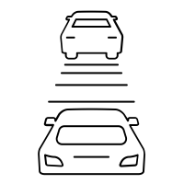


Project Phases
1
2
3
4
5
Blind Spot Detection
Lane Departure
Adaptive Cruise Control
Bump Detection
Traffic Sign Recognition

Slide 10
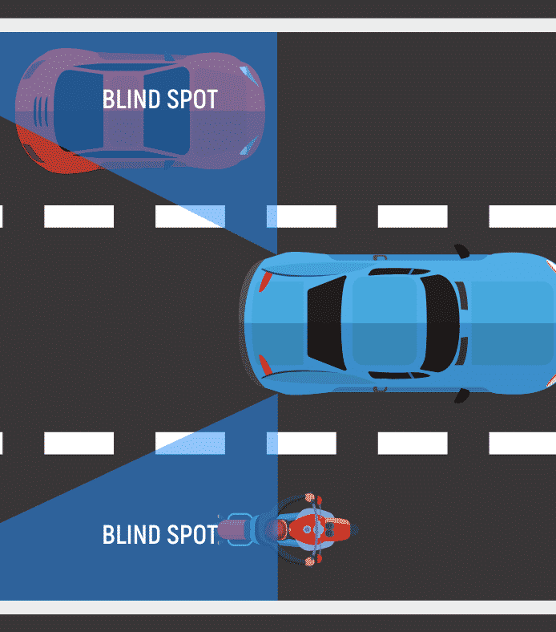
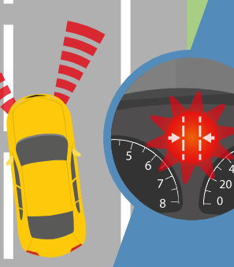
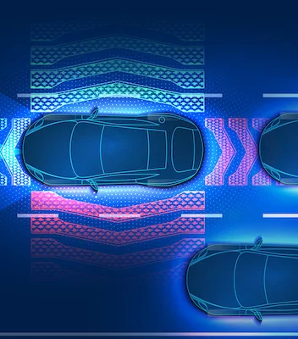
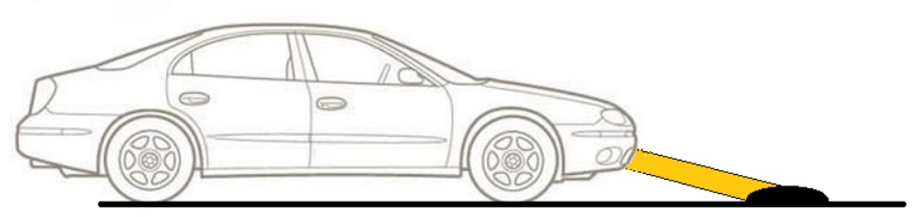
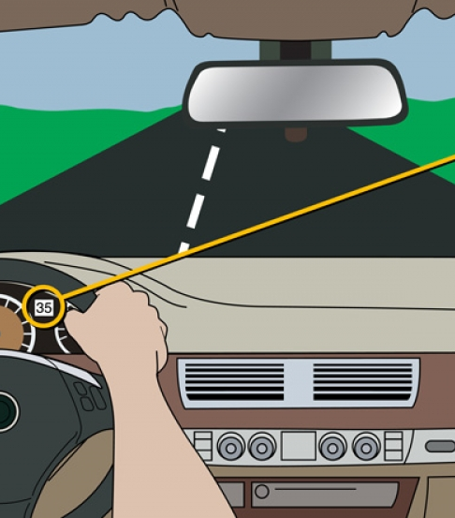
Project functions
Blind Spot Detection (BSD)
Adaptive cruise Control
Lane Departure
Bumb Detection
Traffic sign Recognition
BSD technology helps drivers identify vehicles in their blind spots and alerts them to avoid dangerous maneuvers.
LDW alerts drivers when their vehicle unintentionally drifts out of their lane.
ACC that adjusts the vehicle's speed automatically to maintain a safe distance from the vehicle ahead.
Bumb detection systems are equipped to detect and alert drivers of speed bumps and other road irregularities.
Traffic Sign Recognition can interpret and display traffic signs to keep drivers informed about speed limits, no-entry signs, and more.

Slide 11
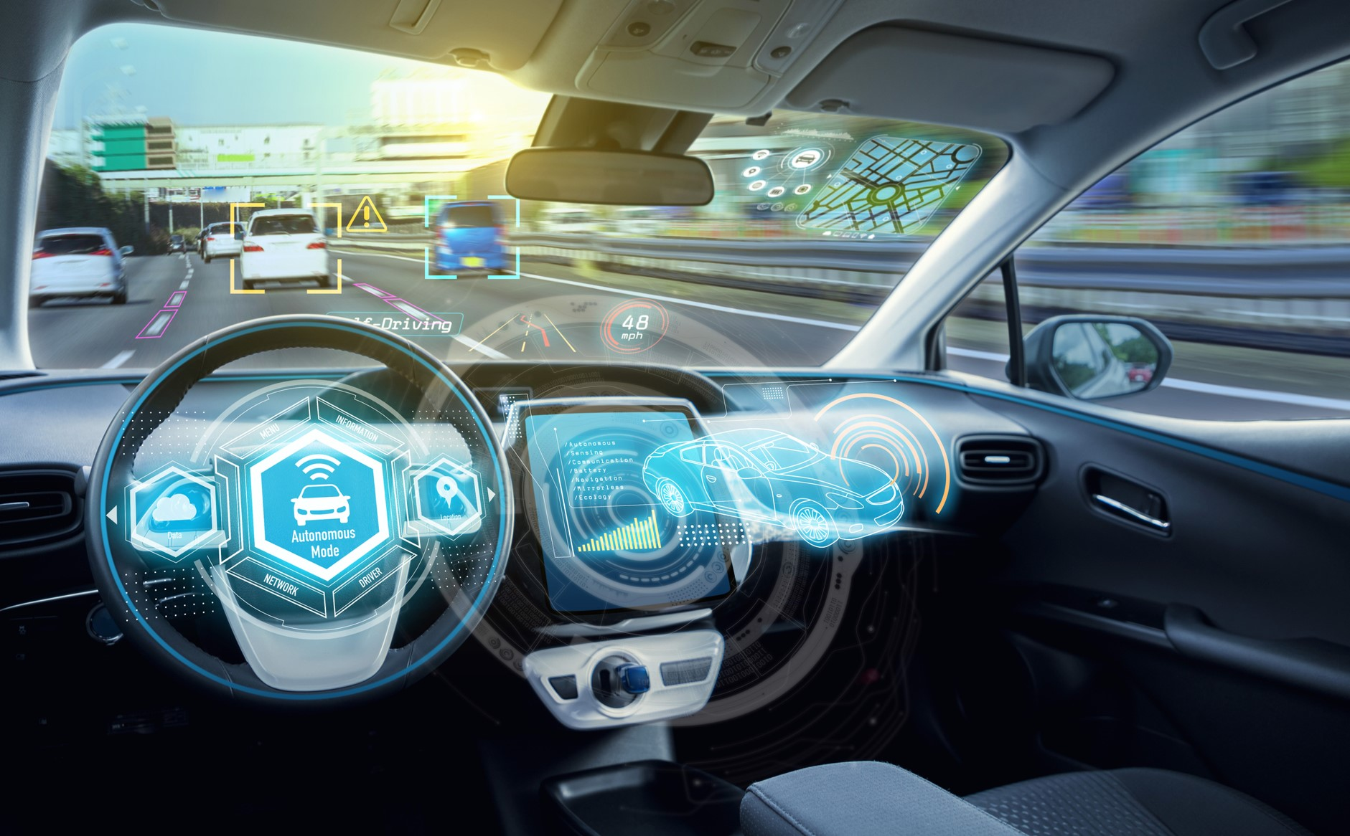
SYSTEM ARCHITECTURE
This system consists of Two subsystem or in other words Two ECUs - Electronic Control Unit – .
• Robotic Car controlled by Bluetooth: It is an Experimental Platform to test the ADAS system, using Bluetooth the car moves forward or back, turn right of lift or change its velocity.
• ADAS: It is a Microcontroller connected to sensors and uses the power of Machine learning(ML) to be aware of the environment around the vehicle interrupts the Robotic Car in need and send the required function.

Slide 12
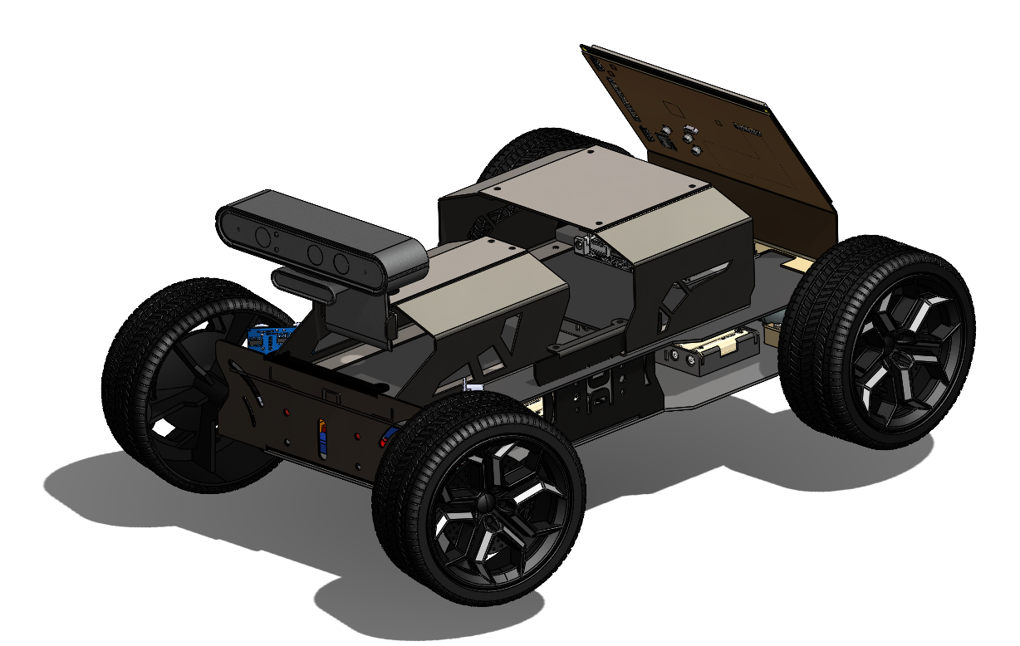
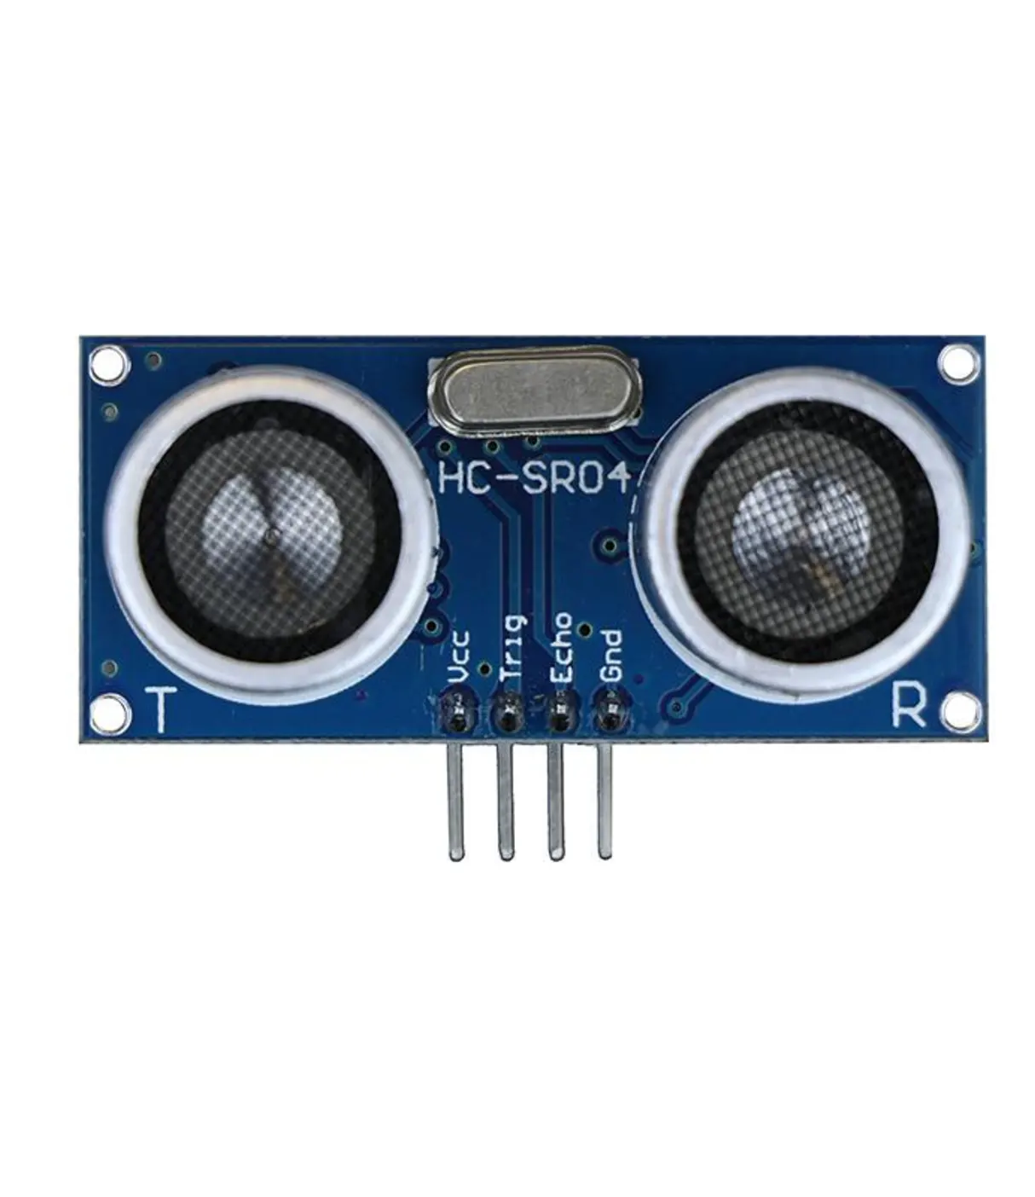
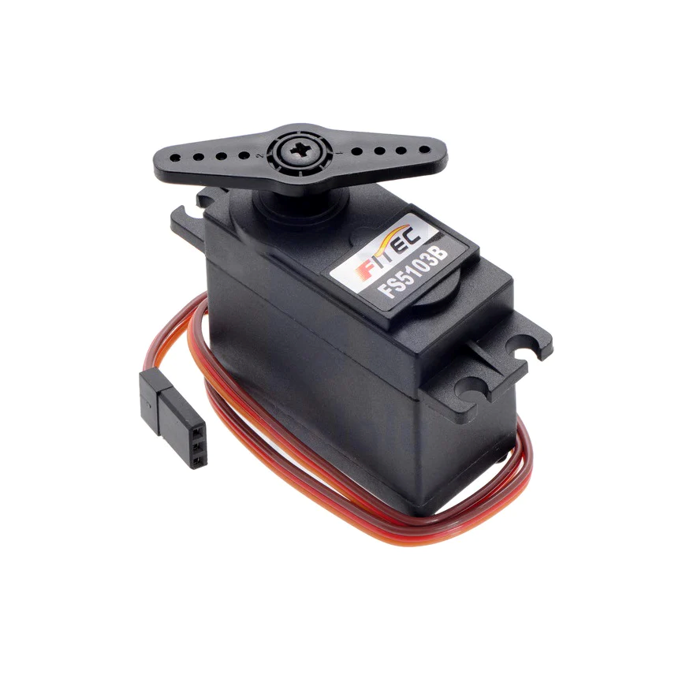
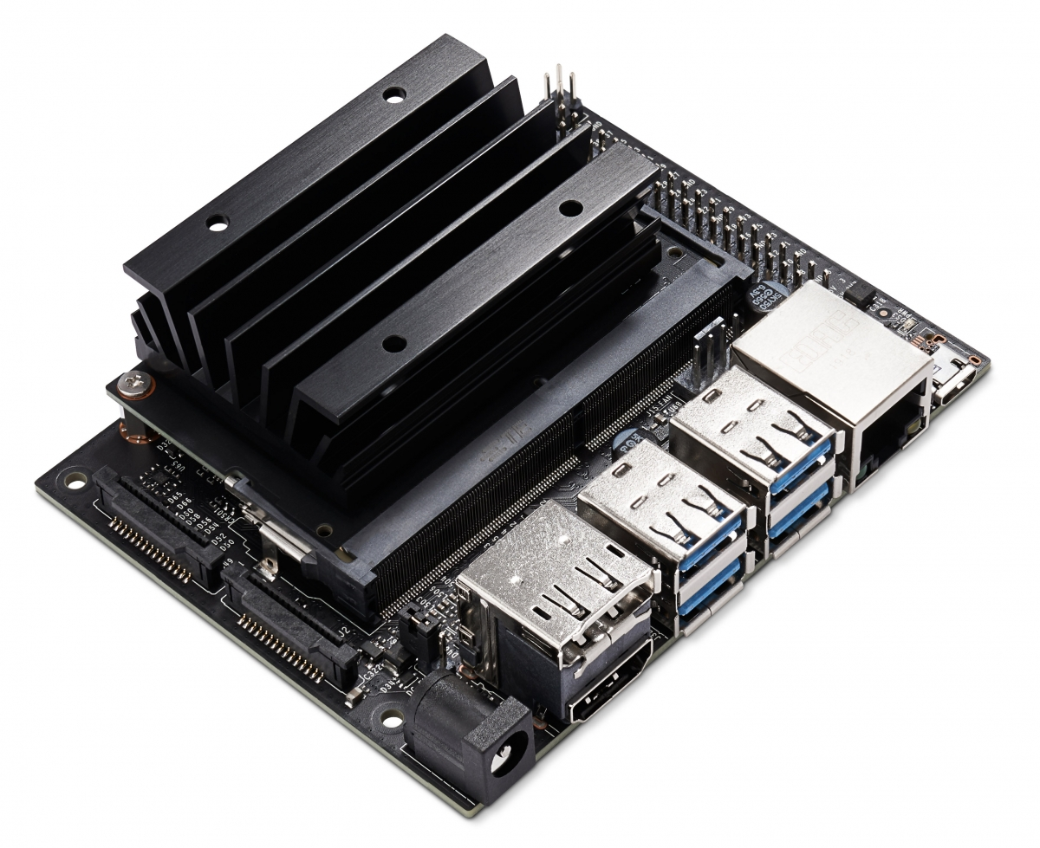

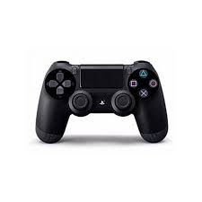
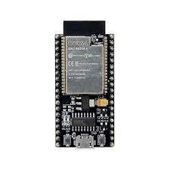
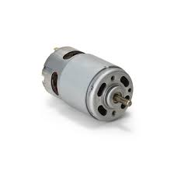
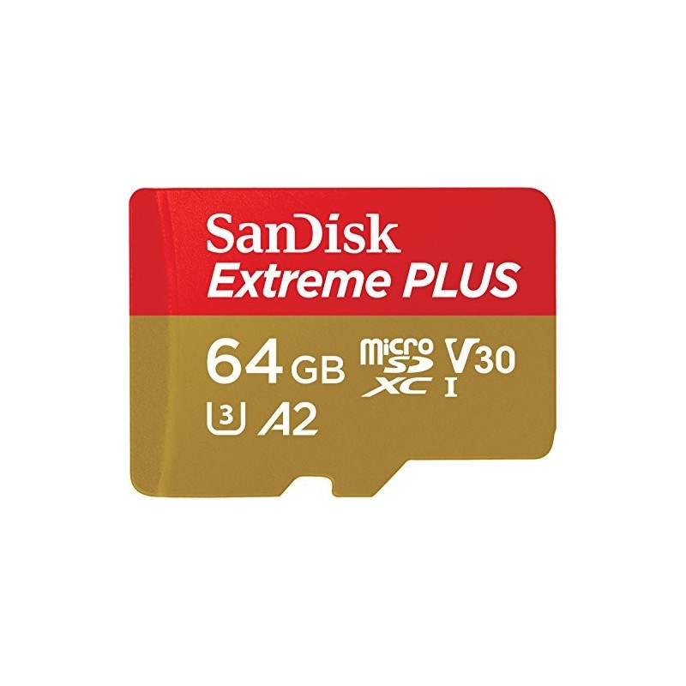
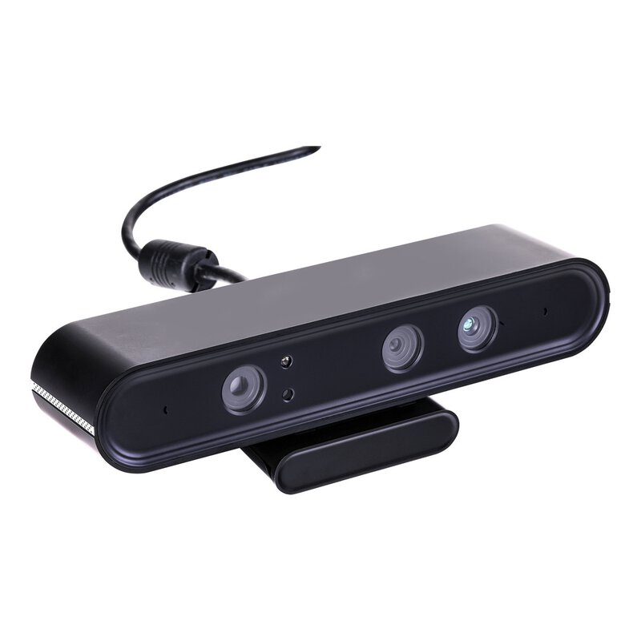
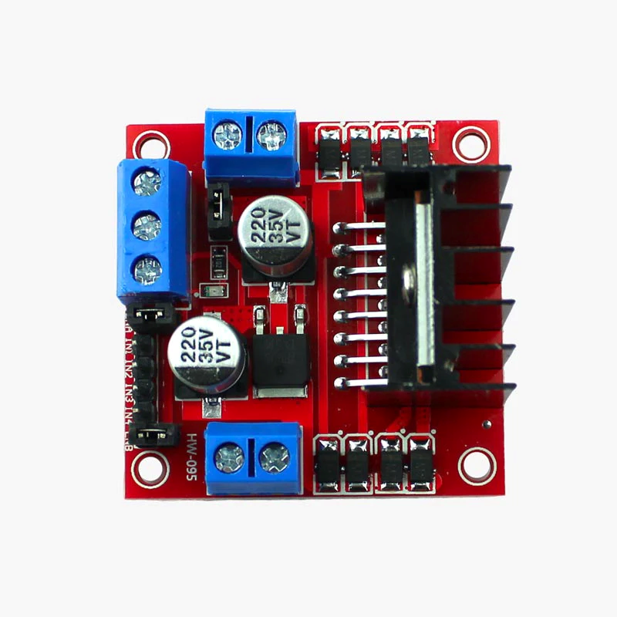
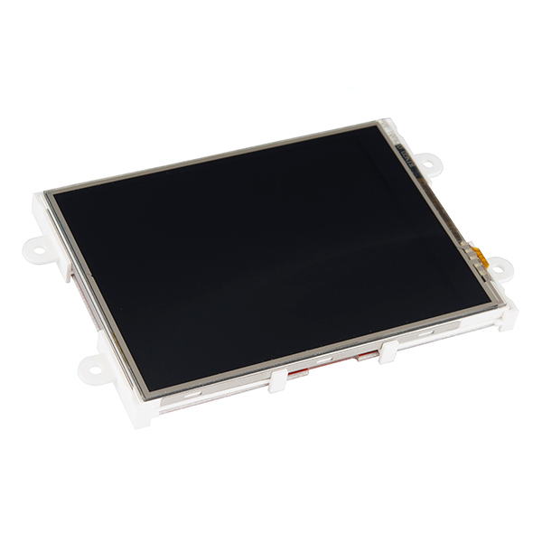
Components
Robotic Car
Ultrasonic Sensor
Servo Motor
Nvidia Jetson
PS4 Controller
Power Supply
MicroSD Card
ESP32
Motors
Astra Pro Plus Depth Camera
5- inch Screen
Motor Driver

Slide 13
Tools
Embedded System
Python
YOLO
Tensorflow
OpenCV
Yolo5
Numpy

Slide 14
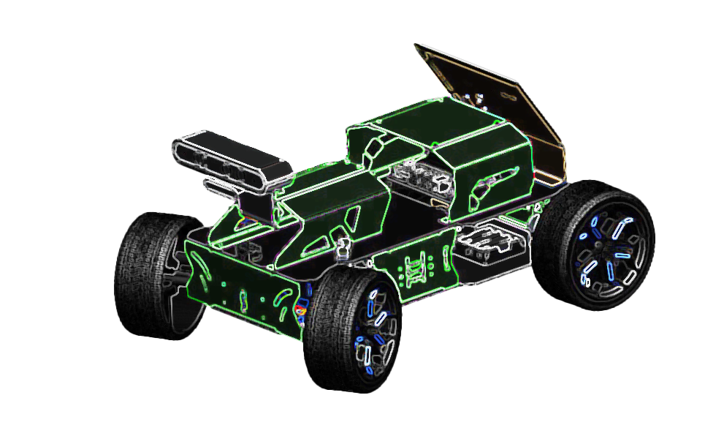
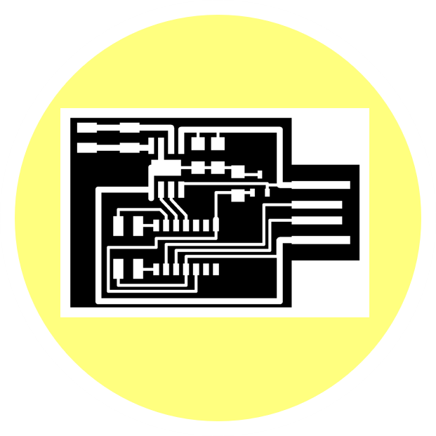

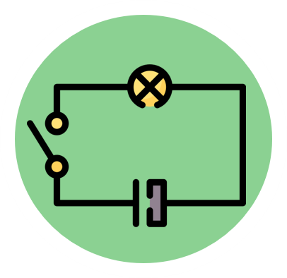




Car Movement

Slide 15
Introduction
The car body is the most important thing in our project. It coverall the wiring and components. It combines all our systems and makes it a complete embedded system. The movement of the body is also important. With the movement control system, we can test our ADAS to make sure those run properly.

Slide 16
Car Movement

Slide 17
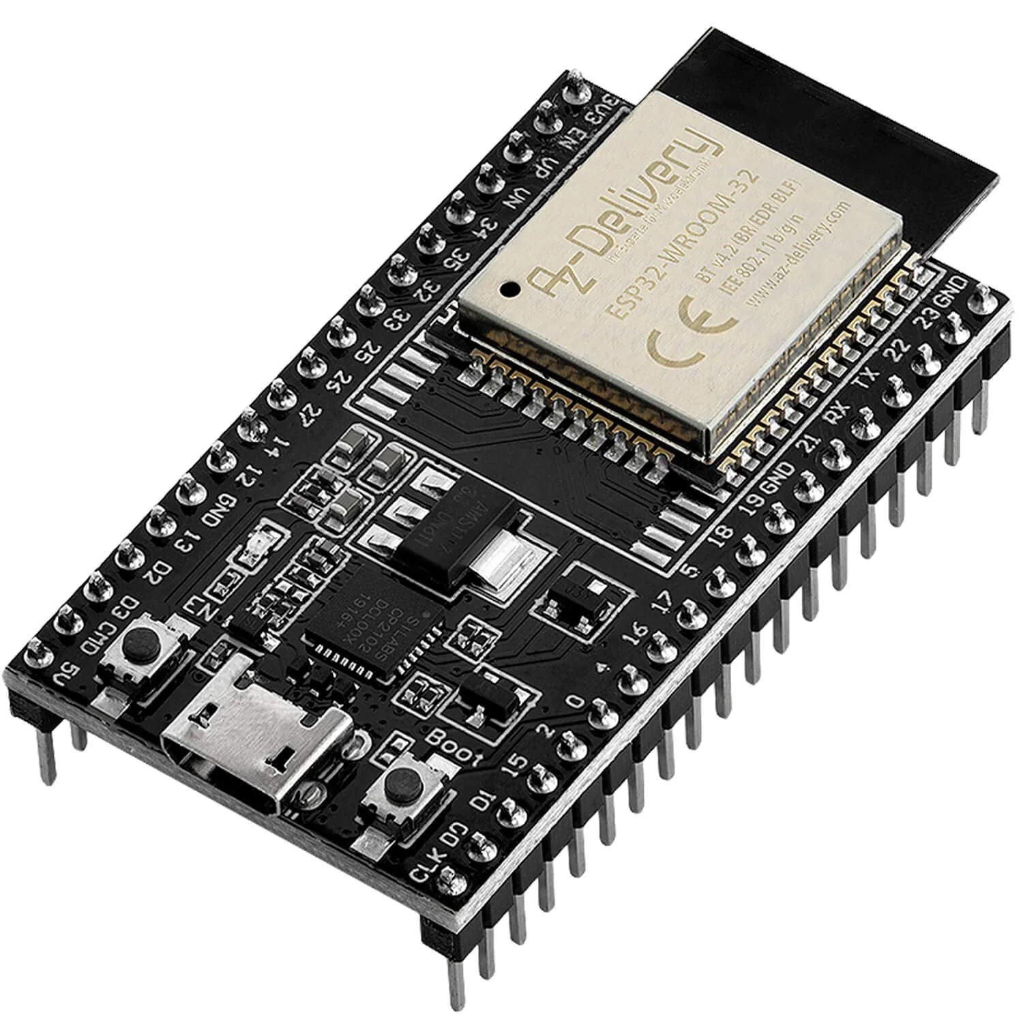
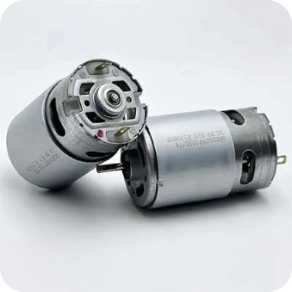
Components
Esp32
12 Volt DC Battery
2 Dc Motors
L298N H Bridge Module
PS4 Controller

Slide 18
Car Movement

Slide 19
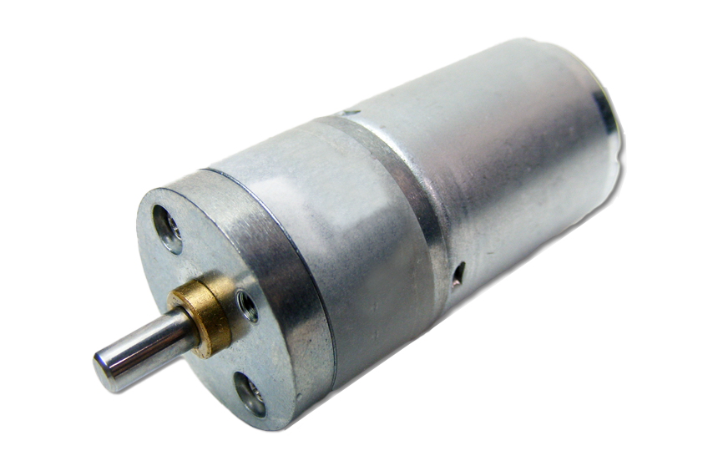
Dc motor
A DC motor is a type of electric motor that operates using direct current (DC) electricity. It converts electrical energy into mechanical motion through the interaction of magnetic fields. DC motors can give us high torque in comparison with its small size. With these specifications we can use dc motor in our project.

Slide 20
Car Movement

Slide 21
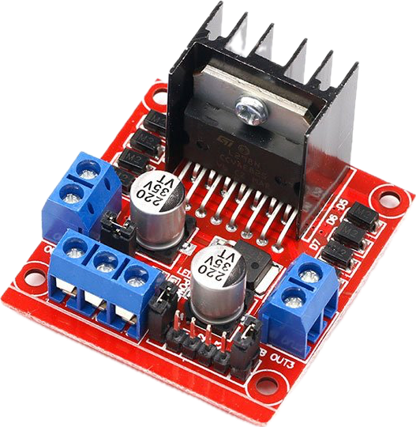
Dc motor driver
(L298N) To control the speed of a dc motor we need a Pulse Width Modulation (PWM) signal. The device that can handle that pulses is DC motor driver. It not only handles the pulses it also can handle the large current from the motor to prevent the current from the MCU.

Slide 22
Car Movement

Slide 23
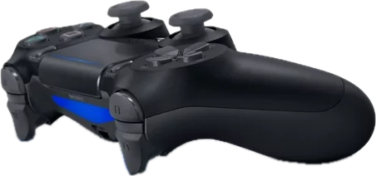
Controlling the car
We need a joystick to control our car wirelessly. When we press a button on the joystick, we want a motor to move. To make this happen we need a MCU that supports bluetooth connectivity, PWM pins to control the motor, and can support connection protocols to communicate with other MCU’s.

Slide 24
Car Movement

Slide 25


ESP32

Slide 26
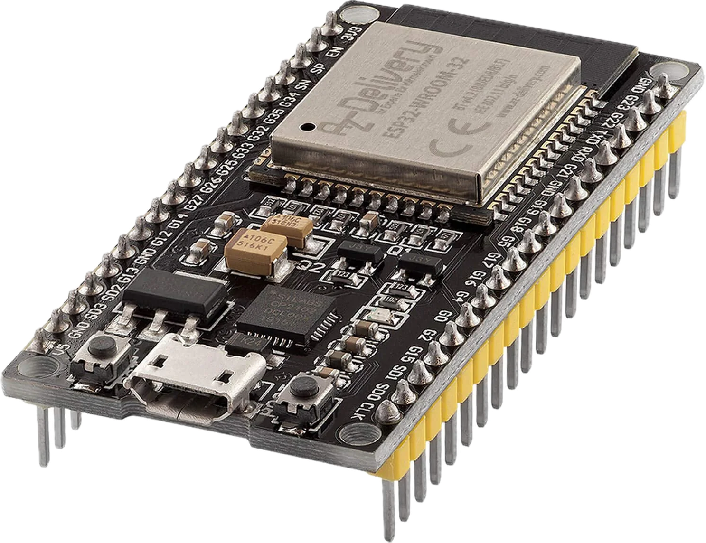
What IS ESP32
The ESP32 microcontroller is utilized in car movement for advanced driver assistance systems (ADAS). With its powerful processing capabilities and built-in wireless connectivity, the ESP32 enables real-time data acquisition and analysis for features like collision avoidance, lane departure warning, and adaptive cruise control, enhancing overall vehicle safety.

Slide 27
Why ESP32 Chose Us
ESP32 is our choice that covers our needs. It has Wi-Fi and Bluetooth connectivity. It has PWM pins. It covers all GPIO, I2C, I2S, and UART protocols that we can make connections with other devices.

Slide 28

Car Movement

Slide 29
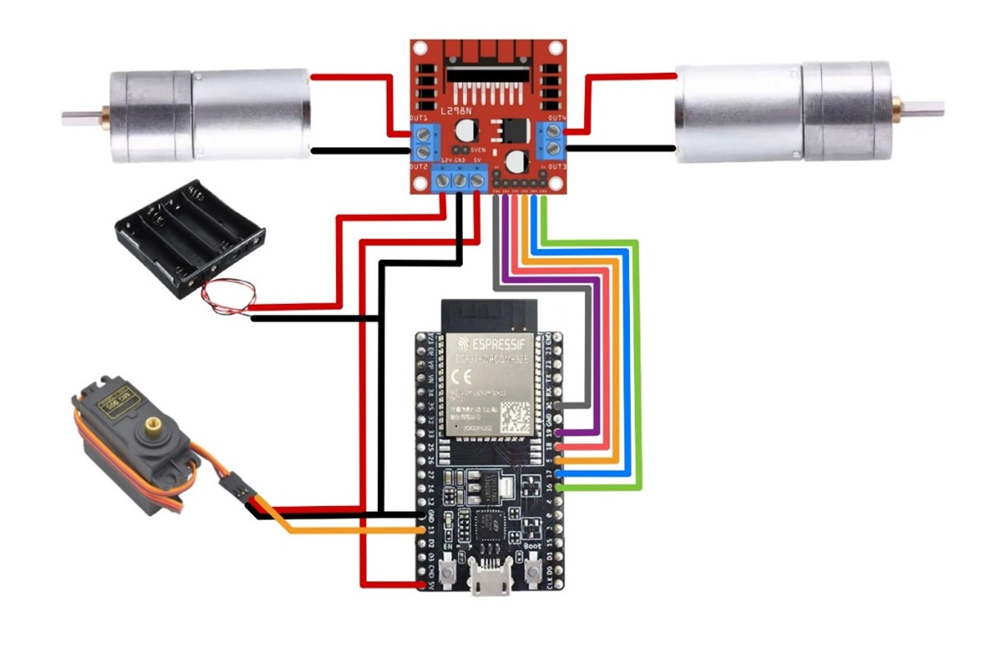
Car Movement- Circuit Diagram

Slide 30
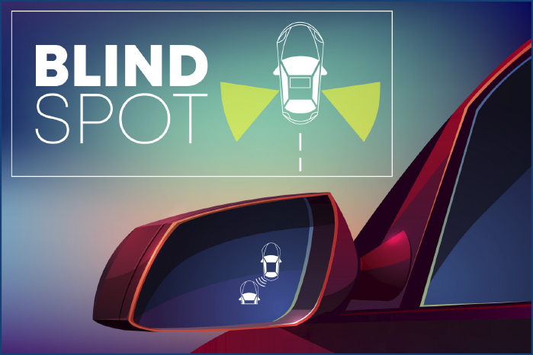
Haneen Salah
85555
Blind SPOT Detection System

Slide 31


Blind Spot Detection System
Introduction
Ultrasonic Sensor
Alert System
01
02
03

Slide 32


Blind Spot Detection System
Introduction
01
Ultrasonic Sensor
Alert System
02
03

Slide 33
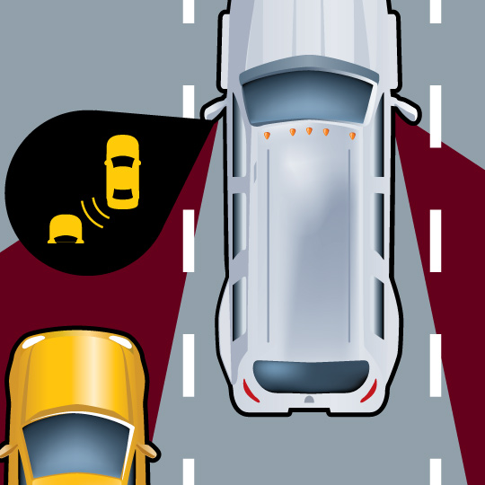
INTRODUCTION
Blind spot detection
Blind spots in vehicles have long been a safety concern, contributing to significant number of accidents. The Blind Spot Detection System is designed to mitigate these risks by employing advanced sensor technologies to monitor and alert drivers about objects or vehicles in their blind spots.

Slide 34
Blind Spot Detection System
Introduction
01
Ultrasonic Sensor
Alert System
02
03

Slide 35


Blind Spot Detection System
Ultrasonic Sensor
Introduction
Alert System
01
02
03

Slide 36
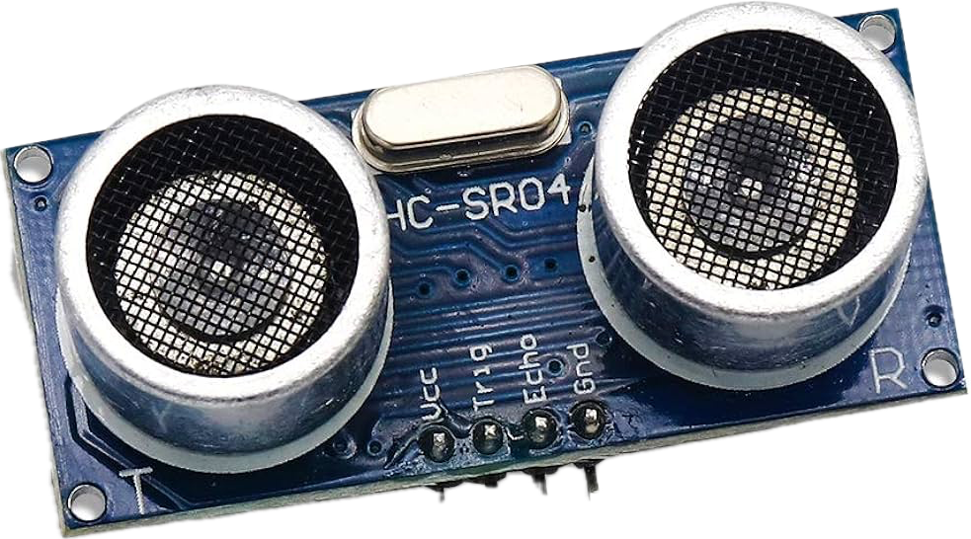

Ultrasonic sensors
Blind spot detection
Ultrasonic sensor uses sound to measure the distance. It transmits an ultrasound signal, when the sound reflects from any object it will be detected by the sensor. Then the sound travels double the distance to go over the object and turn back to the sensor. This is how the sensor measures the distance.

Slide 37
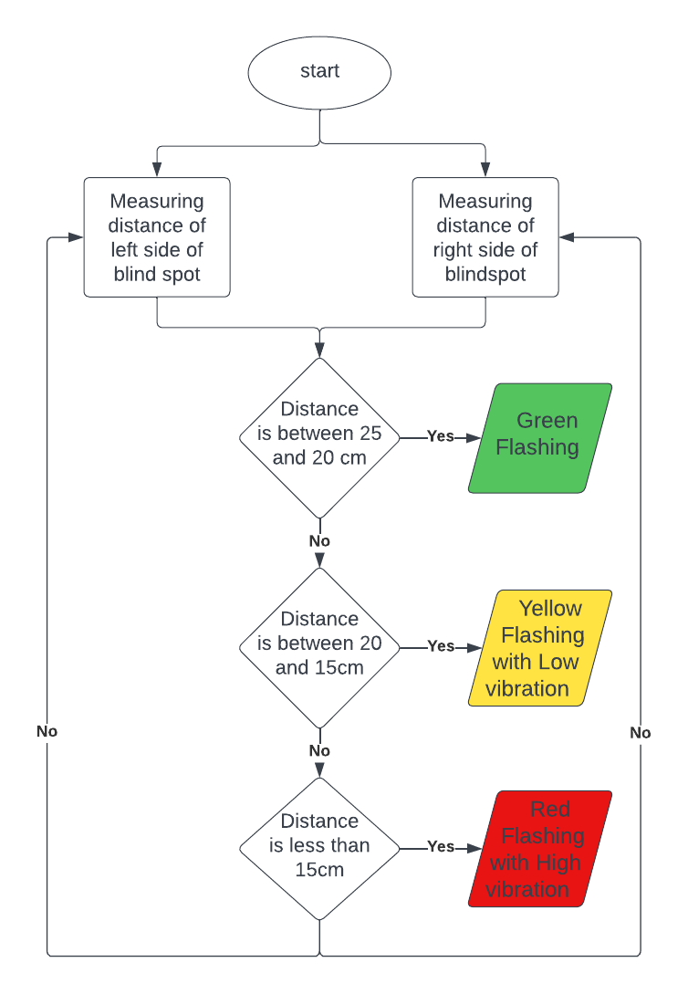
Blind Spot Detection- Flow Chart
Blind spot detection system

Slide 38
Blind Spot Detection System
Ultrasonic Sensor
Introduction
Alert System
01
02
03

Slide 39

Blind Spot Detection System
Alert System
Introduction
Ultrasonic Sensor
01
02
03

Slide 40

Alert system
Blind spot detection
From the measurements of the object’s position, we can make a threshold to alert the driver at danger. If the object is almost to crash the car, the car itself can make an action to the other direction to prevent the accident.

Slide 41
Blind Spot Detection System
Alert System
Introduction
Ultrasonic Sensor
01
02
03

Slide 42
Blind Spot Detection System
Introduction
Ultrasonic Sensor
Alert System
01
02
03

Slide 43
Blind Spot Detection- System Block Diagram
Blind spot detection system
Node MCU ESP32
Ultrasonic Sensor
Measure Distance
Decision Logic
Alert System
Make Action

Slide 44
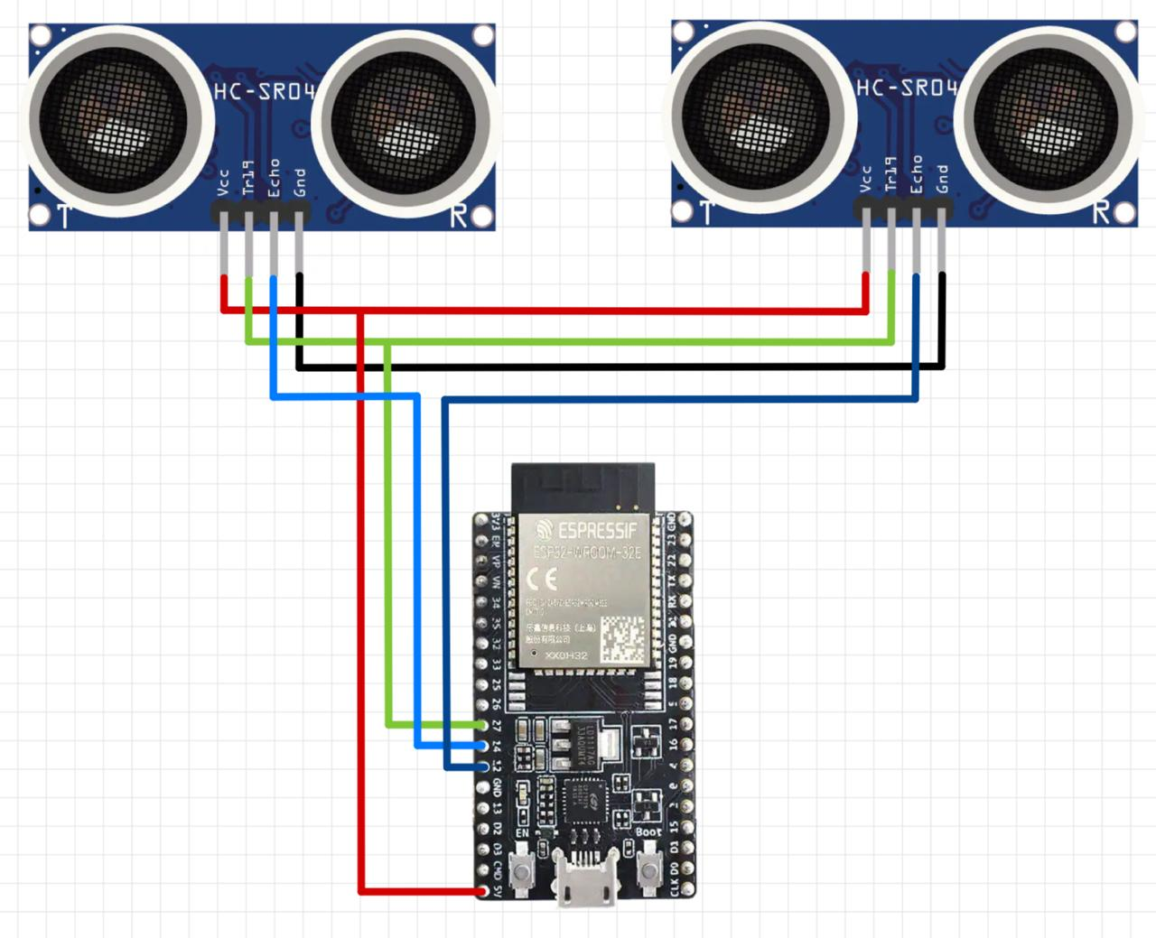
Blind Spot Detection- System Block Diagram

Slide 45
Blind Spot Detection System
The Blind Spot Detection System stands as a critical innovation in automotive safety, addressing a long-standing concern and significantly enhancing the driver's ability to navigate traffic safely. As technology continues to evolve, ongoing research and development in this field promises to further refine and expand the capabilities of Blind Spot Detection Systems, contributing to a safer and more secure driving environment for all road users.

Slide 46
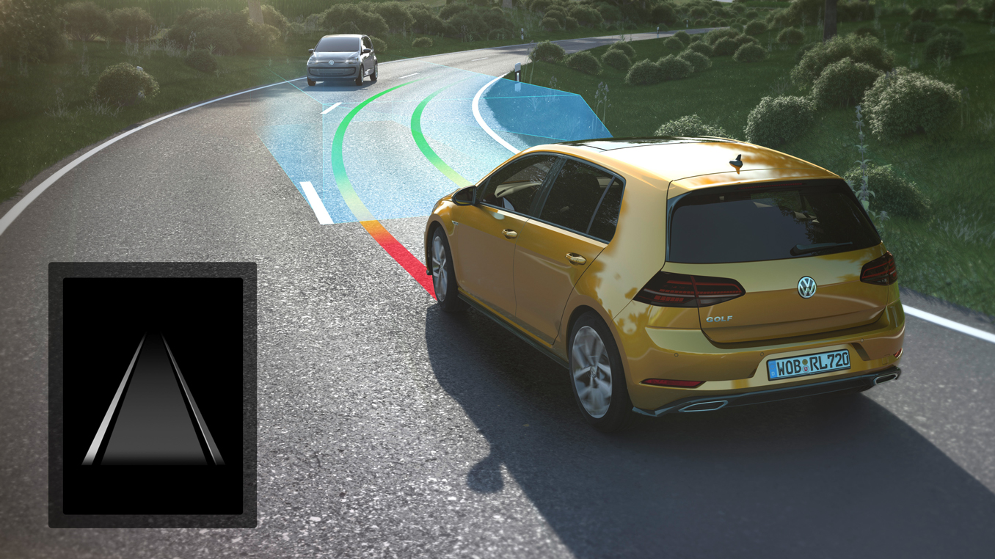
Lane Departure
Mahmoud Mohamed
Abdelrahman Amr

Slide 47
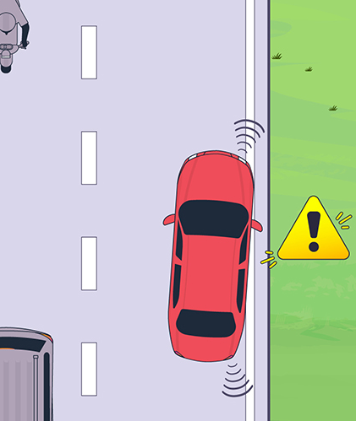
Problem Statement
Crashes resulting from lane departures can be among the deadliest collisions. In 2015, nearly 13,000 people died in single-vehicle run-off-road, head-on, and sideswipe crashes where a passenger vehicle left the lane unintentionally.

Slide 48
Lane departure System
It's a critical safety feature that helps drivers stay within their lanes and avoid accidental lane departures. By using cameras and sensors, this advanced technology can detect if a vehicle is drifting out of its lane and provides timely alerts to the driver, reducing the risk of accidents and promoting safer driving.

Slide 49
Types Of Lane Departure Warning System:
Lane Departure Warning (LDW): Systems Which Warn The Driver If The Vehicle Is Leaving Its Lane.
Lane Centering Assist (LCA): Keep The Car Centered In Its Current Lane And Ask The Driver To Take Over In Challenging Situations.
Lane Keeping System (LKS): Systems Which Warn The Driver And, If No Action Is Taken, Automatically Take Steps To Ensure The Vehicle Stays In Its Lane.

Slide 50
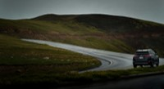
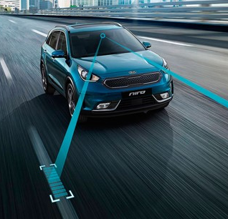


Advantages Of Lane Departure
Enhanced Safety
Reduced accidents
Better driving
LDW systems can improve driver awareness and attentiveness

Slide 51
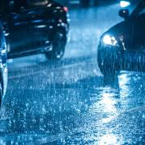
Disadvantages Of Lane Departure
Limited Effectiveness In Certain Conditions:
False Alarms:
LDW systems prone to false alarms, driver annoyance, and distraction.

Slide 52
Lane departure system
The methods for lane departure warning can be classified into two categories:
1. Sensor-based methods.
2. Vision-based methods.

Slide 53
Lane Departure system
Sensor-based methods
Use devices such as radar, laser sensors, and even global positioning systems (GPS) to detect whether a vehicle departed a lane based on:
Information of the vehicle ahead.
The position calculated by GPS.

Slide 54
Vision-based methods
It detects the road lanes based on the features of a camera image such as color gradient, histogram, or edge.
Vision-based methods
Model-based methods: Which creates a mathematical model of the road structure. They use the geometric coordinates of the camera and the road as input parameters and depend on their accuracy.

Slide 55
Model-based Methods
• Advantages:
Good for varying road geometries and conditions.
Accurate in estimating Lane curvature and orientation.
• Disadvantages:
Complex to implement.
Sensitive to model parameters.

Slide 56
Vision-based methods
Vision-based methods
Feature-based methods: Which can discriminate feature points of lane markings from the non-lane areas by characteristic features of the road, such as color, gradient, or edge. This method is simple, but they require a clear and strong color contrast of the lane and good road condition.

Slide 57
Feature-based Methods
• Advantages:
Simple to implement.
Adaptive to different lighting and environmental conditions.
• Disadvantages:
Adaptive to different lighting and environmental conditions.
Limited in handling curved or unmarked lanes.

Slide 58
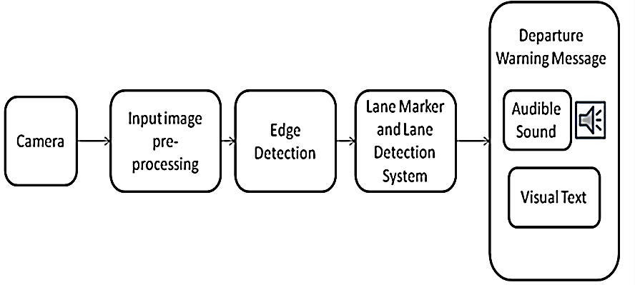
Lane Departure System- Block diagram

Slide 59
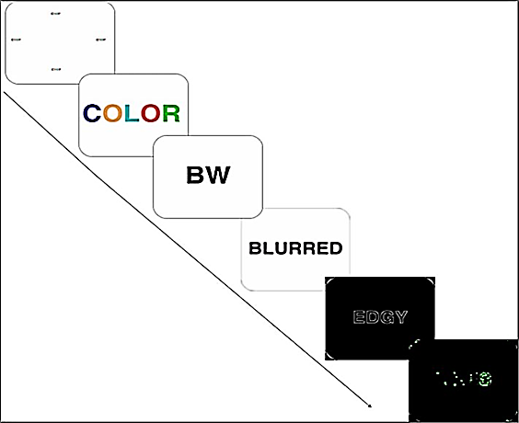
How Lane Departure System Works
Lane Departure

Slide 60
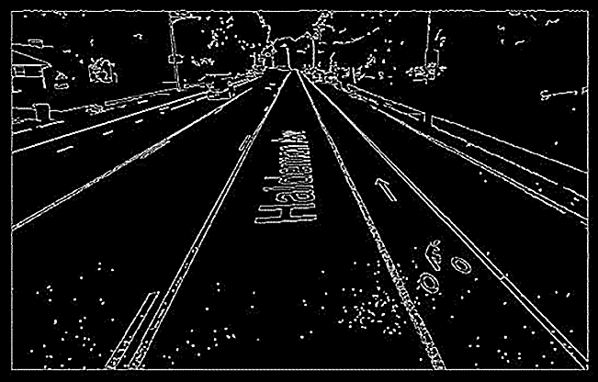
How Lane departure system Works
Edge detection: canny or Gaussian filter

Slide 61
How Lane departure system Works
Edge Detection : Edge detection plays a vital role in Lane departure warning system, through which lanes are detected.
Some of edge detection Methods: Sobel operator, Prewitt operator, Robert operator. Gaussian, Canny edge detector and Laplacian .
We use in the code canny edge detection

Slide 62
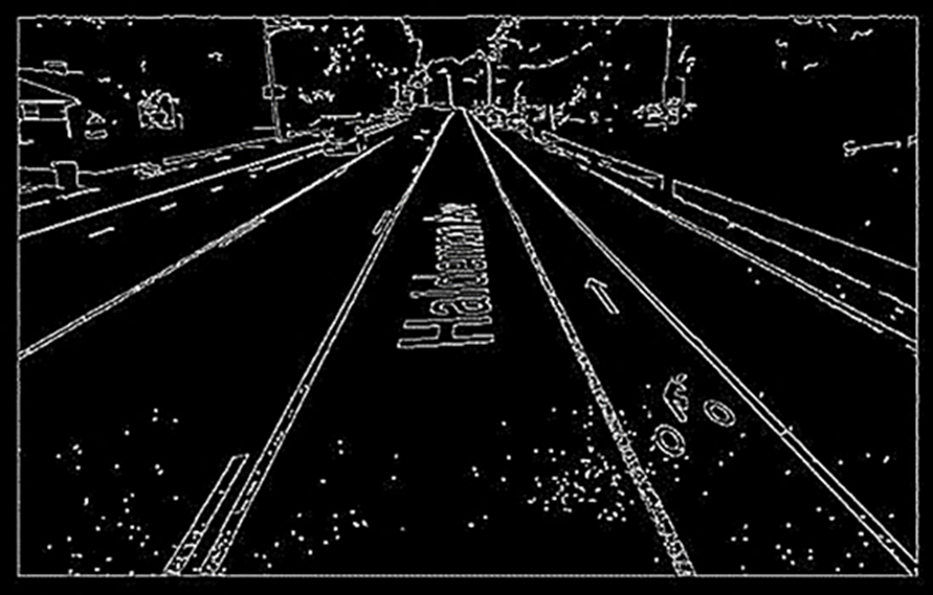
How Lane departure system Works
Canny edge detection: a technique to extract useful structural information from different vision objects and reduce the amount of data to be processed.

Slide 63
How Lane departure system Works
The Canny filter is widely used filter for edge detection.
Canny edge detection algorithm produces smoother, thinner, and cleaner images than Sobel and Prewitt filters.
Advantage Detection of edge with low error rate, which means that the detection should accurately catch as many edges shown in the image as possible
Disadvantage are that it is more complex and computationally intensive than the Sobel filter, and that it requires manual tuning of the parameters to achieve optimal results.

Slide 64
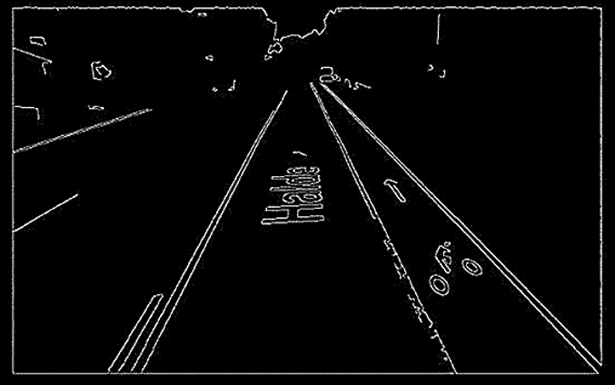
How Lane departure system Works
Edge detection: canny or Gaussian filter (Blurred)

Slide 65

How Lane departure system Works
Blurring the image is a process that makes the image less sharp and reduces its level of detail. It distorts the detail of an image which makes it less clear.

Slide 66
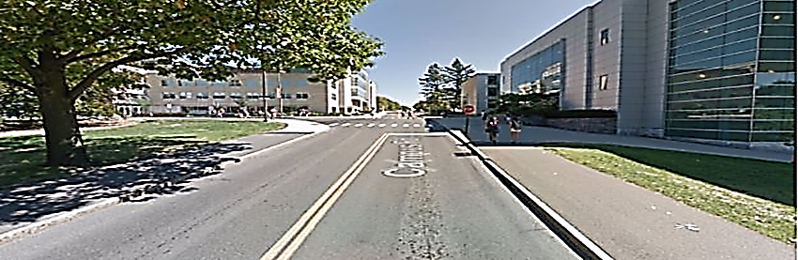
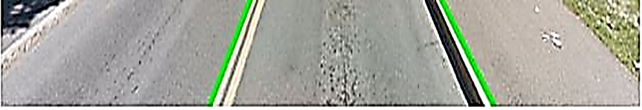
How Lane departure system Works
Image Before crop
After crop and lane detection

Slide 67
How Lane Departure System Works
Houghline method : The Hough Transform is a method that is used in image processing to detect any shape, if that shape can be represented in mathematical form like extract lines, circles and ellipses (or conic sections).
To apply the Houghline method, first an edge detection of the specific image is desirable

Slide 68

How Lane departure system Works
Vehicle is within lane bounds

Slide 69

How Lane departure system Works
Deviation of the vehicle

Slide 70
How Lane departure system Works
slope = ((top center y) – (bottom center y)) / (top center x – (bottom center x)
if (-5<slope<0) Turn Right
if (5>slope>0) Turn Left

Slide 71



(Input/output) lane departure
Astra pro plus depth camera
Visual/audio alerts
Real-time monitoring of the vehicle's position on the road
Immediate notifications to ensure driver stays within the lane

Slide 72

Lane Departure Components
Components:
Specification:
Astra Pro Plus Depth Camera:
Range: 0.6-8m
Accuracy: 1m: ±3mm
Resolution@fps: 1920*1080@30fps
/1280x720@30fps
/640x480@30fps​
FOV: H66.73° V40.19° @1920*1080
H66.99° V40.37° @1280*720
H60.60° V46.81° @640*480
​
Astra Pro Plus Depth Camera.

Slide 73
Lane Departure Components
Components:
Specification:
Nvidia Jetson Nano kit 4 GB
Nvidia Jetson Nano:
GPU Maximum Operating Frequency: 921MHz
CPU Maximum Frequency: 1.43GHz
Memory Capacity: 4GB
Module Power: 5 – 10W
Power supply Input: 5.0V
​

Slide 74

Adaptive Cruise control
Abdelrahman Mohamed

Slide 75

INTRODUCTION
The term Cruise Control refers to the concept of assisting drivers in the task of longitudinal vehicle control to avoid any accident or collision.

Slide 76
DESCRIPTION
01
Adaptive Cruise Control (ACC) is an important feature in Advanced Driver Assistance Systems (ADAS).
02
It automatically adjusts a vehicle's speed when there are slow-moving vehicles ahead, with the aim of maintaining a safe following distance.
03
When the path is clear, the ACC system returns the vehicle to the driver's selected speed.
04
These advancements in ADAS are crucial for improving road safety and enhancing the capabilities of autonomous vehicles

Slide 77
DESCRIPTION
01
Adaptive Cruise Control (ACC) is an important feature in Advanced Driver Assistance Systems (ADAS).
02
It automatically adjusts a vehicle's speed when there are slow-moving vehicles ahead, with the aim of maintaining a safe following distance.
03
When the path is clear, the ACC system returns the vehicle to the driver's selected speed.
04
These advancements in ADAS are crucial for improving road safety and enhancing the capabilities of autonomous vehicles.

Slide 78
DESCRIPTION
01
Adaptive Cruise Control (ACC) is an important feature in Advanced Driver Assistance Systems (ADAS).
02
It automatically adjusts a vehicle's speed when there are slow-moving vehicles ahead, with the aim of maintaining a safe following distance.
03
When the path is clear, the ACC system returns the vehicle to the driver's selected speed.
04
These advancements in ADAS are crucial for improving road safety and enhancing the capabilities of autonomous vehicles.

Slide 79
DESCRIPTION
01
Adaptive Cruise Control (ACC) is an important feature in Advanced Driver Assistance Systems (ADAS).
02
It automatically adjusts a vehicle's speed when there are slow-moving vehicles ahead, with the aim of maintaining a safe following distance.
03
When the path is clear, the ACC system returns the vehicle to the driver's selected speed.
04
These advancements in ADAS are crucial for improving road safety and enhancing the capabilities of autonomous vehicles

Slide 80

ACC Working Principle
01
02
03
04
Works by detecting the distance and speed of the vehicles ahead by using either a LIDAR system or a RADAR system.
The time taken by the transmission and reception is the key to the distance measurement.
The shift in frequency of the reflected beam by Doppler Effect is measured to know the speed.
Depending on this speed, the brake and throttle controls are done to keep the vehicle in a safe position.

Slide 81

Adaptive Cruise Control- Block diagram

Slide 82

Adaptive Cruise Control- Block diagram

Slide 83
Adaptive Cruise Control- Block Diagram
Block Diagram Explanation :
ACC uses sensors to monitor the distance between your car and the vehicle ahead, and we can’t forget that there are also obstacles on the road, so we used the 3D depth camera to recognize the height and the distance between the obstacles and the car. And by collecting the inputs by the camera and the sensors and sending it to the microcontroller the output will be:
Audible Alerts: In critical situations, ACC systems can produce audible warnings, such as beeps or alarms, to alert the driver to take action, like braking or steering to avoid a collision by using the Buzzer or sending alerts through the car sound system.

Slide 84
Adaptive Cruise Control- Block Diagram
Block Diagram Explanation :
Visual Warnings: Some ACC systems display visual alerts on the dashboard or instrument cluster. These warnings might include flashing lights, icons, or messages indicating a potential collision or need for driver intervention.
Acceleration and Braking: ACC can slow down your vehicle by reducing throttle or even apply the brakes if necessary to maintain a safe distance. Once the road ahead is clear, it can accelerate back to the preset speed by the presence of the speed controller.

Slide 85
Sensors
SENSOR is a converter that measures physical quantity and converts it into signal which can be read by observer or by instrument.
SENSOR responds to an input quantity by generating a functionally related output usually in form of electrical or optical signal.
In this project types of SENSOR can be used :
LiDAR
Fusion Sensor (Camera)
These two parts work together to track the car from nonmoving object.

Slide 86

LiDAR
LIDAR stands for "Light Detection and Ranging".
It measure distance by illuminating laser and analyzing the reflected light.
LiDAR is a ranging device, which measures the distance to a target . The distance is measured by sending a short laser pulse and recording the time lapse between outgoing light pulse and the detection of the reflected (back-scattered) light pulse.

Slide 87

Controller action
Depending on the present traffic situation two type of controller are possible SPEED CONTROL and HEADWAY CONTROL.
SPEED CONTROL: if there is no vehicle presently in front, then the speed is controlled about a set point just as in conventional cruise control.
HEADWAY CONTROL: to keep a safe distance between the vehicle’s headway control is required.

Slide 88
Advantages Of ACC
Driver is relieved from careful acceleration, deceleration and braking in congested traffics.
Accidents can be reduced.
It’s very useful for long driving.
Can avoid unconsciously violating speed limits.
Increased fuel efficiency.

Slide 89
Disadvantages of ACC
High Cost.
Not for heavy traffic.
Encourages the driver to become careless.
Dangerous in slippery roads.
The ACC systems do not respond directly to the traffic.

Slide 90

Future Scope
The advanced version of ACC is known as Cooperative Adaptive Cruise Control (CACC) . In CACC preceding vehicle can communicate actively with the following vehicle so that their speed can be coordinated with each other.

Slide 91



Problem Statement
Problem Statement Cont.
Description
Most of the bumps in Egypt are randomly placed without engineering studies and are not being constructed and maintained according to public safety, which causes damage to vehicles, severe discomfort to the driver, and can even cause a loss of maneuver control leading to fatalities.
To solve the problem of road bumps in Egypt, a bump detection feature focuses on alerting the driver visually or acoustic about bumps. When the driver encounters a bump, the bump is detected by a depth camera.
Road anomalies have always been a bad sign of road quality. Rough roads and speed bumps endanger the safety and comfort of car drivers. In Egypt, there is a statistic indicating that 40% of accidents result from randomly positioned speed bumps, so this feature focuses on the problem of bumps in Egypt and provides a solution for it.
Bump Detection
Toqa Hamdy
Yousef Mohamed
Omar Hosny

Slide 92

Bump Detection- Block Diagram
Explanation
The camera captures the road
The machine learning model scan for the bump in the photo
If the object detected is a bump the depth camera will measure the distance between the car and the bump, if not, the depth camera will not measure the distance.
The microcontroller will send a message to the screen and buzzer to give alerts as a visual or audible output.

Slide 93


Components
Nvidia jetson Nano
Astra Pro Plus Depth Camera
5- inch Screen
Buzzer

Slide 94
Bump Detection- Components
Components Specs
5-inch Screen:
Size: 5.0 (inch)
Resolution: 800*480 dots
Touch: 4-wire resistive touch
Product Size: 121.11*77.93(mm)
Package Size: 154*135*51 (mm)
Rough Weight(Package containing): 206(g)
Buzzer:
Rated Voltage : 5V DC
Operating Voltage : 4 to 8V DC
Sound Output at 10cm* : ≥85dB
Resonant Frequency : 2300 ±300Hz
Tone : Continuous
Operating Temperature : -25°C to +80°C
Weight : 2g
Astra Pro Plus Depth Camera:
Range: 0.6-8m
Accuracy: 1m: ±3mm
Resolution@fps: 1920*1080@30fps
/1280x720@30fps
/640x480@30fps​
FOV: H66.73° V40.19° @1920*1080
H66.99° V40.37°
@1280*720
H60.60° V46.81°
@640*480

Slide 95
Bump Detection- phases
The Bump Detection Feature is split into two Phases
Measure the Distance between Car and Bump
Detect the Bump

Slide 96

Block Diagram OF Bump Detection

Slide 97




Bump Detection Dataset
A sample of around 500 images from collected dataset is available public through Mendeley Data. In order to train an object detection model we need image height, width, class and bounding box parameters containing xmin, ymin, xmax, ymax of the object. We obtain these by performing labeling. It is performed on our dataset using LabelImg; an open source free tool which saves bounding box parameters of each image in to corresponding xml file. All images are compressed in size for faster training on GPUs without losing information that is needed for the algorithm and compromising too much on accuracy.

Slide 98
Bump Detection- Model Selection
To build effective neural network model, careful selection of network architecture is needed. From the choices of pre-trained models shown in the table below, we have decided to select ssd mobilenet v1 coco because of its faster in inference with not much reduction with respect to mean average precision(mAP) tested on COCO dataset as given in Table
Model name Speed COCO mAP Outputs
faster rcnn inception resnet v2 atrous slow 37 Boxes
faster rcnn resnet101slow medium 32 Boxes
ssd mobilenet v1 fast 21 Boxes

Slide 99
Why Mobilenet SSD Model?
MobilenetSSD is an object detection model that computes the bounding box and category of an object from an input image. This Single Shot Detector (SSD) object detection model uses Mobilenet as backbone and can achieve fast object detection optimized for mobile devices.

Slide 100

Bump Detection- Distance Measurement
Distance Estimation
In order to save that man from death, he needs to know the distance between him and the speed bump so he can place the correct order at the appropriate time.

Slide 101

Bump Detection- Distance Measurement
Model Selection
Based on our research we two different ways to detect distance of an object which are:
Deep learning model
Algorithm (Single camera)

Slide 102
Bump Detection- Distance Measurement
Deep Learning Model for Distance Estimation
Train a deep learning model that takes in bounding box coordinates of the detected object and estimates distance to the object.
Input: bounding box coordinates (xmin, ymin, xmax, ymax) )& real x, y &z dimensions
Output: distance (z)
Dataset: kitti dataset

Slide 103

Bump Detection- Distance Measurement
Deep Learning Model for Distance Estimation
bounding box coordinates (xmin, ymin, xmax, ymax) )& real x, y &z dimensions

Slide 104

Bump Detection- Distance Measurement
Dataset for Distance Estimation
Why kitti dataset?
Environment of images is close to our target environment.
Accurate ground truth is provided.

Slide 105
Bump Detection- Distance Measurement
Advantages of Deep Learning Model
Cheap hardware, it uses only single camera.
Easy configuration.
High accuracy when tested on images in the data set.

Slide 106

Bump Detection- Distance Measurement
Single Camera Algorithm
Algorithm (Single camera)
Steps :
$F=\frac{P×D}{W}$
P :apparent width in pixels F: focal length
D : distance from our camera
Then apply this equation
$$D=\frac{W×F}{P}$$

Slide 107

Bump Detection- Distance Measurement
What is Apparent Width in Pixel
The apparent width in pixels refers to the size of an object as it appears on a digital display or image, measured in pixels.
$$P=(width×pixel densiy)/distance$$

Slide 108
Bump Detection- Distance Measurement
Advantages of Single Camera Algorithm
Easy to apply
Cheap hardware

Slide 109

Image recognition:
Importance of image recognition.
Understanding Visual Data.
Automation and Efficiency.

Slide 110

Image recognition:
2. Benefits of Integration.
3. Various applications.
Role of Data and Computing Power.

Slide 111

YOLOv5:
YOLOv5, short for "You Only Look Once version 5,"
YOLOv5 is an advanced object detection algorithm that has gained popularity in the field of computer vision.
YOLOv5 offers improved accuracy and speed in real-time object detection tasks.

Slide 112
YOLOv5:
Architecture and Innovation.
Backbone(CSPDarkNet).
Neck (PANet).
Head (YOLOv5 Head).
Training Process and Optimization:
Data preparation.
Model configuration.
Optimization.

Slide 113








Bump detection Using YOLOv5:
02
Configuration of the model.
01
Preparing Dataset .
04
03
Testing the trained model.
Training the model.

Slide 114
Bump detection Using YOLOv5:
1. Preparing Dataset:
A sample of around 500 images from collected dataset is available public through Mendeley Data.
Labeling , we performed labeling in our dataset using open-source tool free called Labeling.
All images are compressed in size for faster training on GPUs without losing information that is needed for the algorithm.

Slide 115
Bump detection Using YOLOv5:
2. Configuration of the model:
Choose a programming environment.
Import libraries and tools.
Writing the commands responsible for Configuration of the model.

Slide 116
Bump detection Using YOLOv5:
3. Training the model:
Open the script “train.py”.
Modify the script to set the desired parameters such as --img-size, --batch-size, --epochs, --data, and --cfg according to our requirements.
Run Script.

Slide 117




Training operation

Slide 118
Bump detection Using YOLOv5:
4. Testing the trained model:
Open the script “detect.py”.
Modify the script to set the desired parameters such as --source and --weights according to our requirements.
Run Script.

Slide 119


Testing the trained model

Slide 120

Traffic Sign Recognition
Fesal Mohamed
Ahmed Mohamed

Slide 121

Introduction
The Traffic Signs Manual (TSRI) is a vital guide that provides essential advice for the effective use of traffic signs and road markings. It also the real-time processing and capabilities of AI models. the importance of minimizing sign clutter, the manual recognizes the significance of streamlining information for quick decision-making by intelligent systems.

Slide 122
In this part we will discuss:
CNNS architecture and deep learning.
Object detection.

Slide 123

Deep learning and neural network
As deep learning has developed in the modern collect a lot of data from all around the world has been collected. Many sources, including social media, online ad networks, e-commerce, and virtual theaters, provide vast volumes of information.
A neural network is an algorithmic system that mimics the way the human brain functions to find the relationships that underlie a piece of data. Neural networks in this sense relate to artificial or organic neuronal structures.

Slide 124

CNNS architecture
A unique kind of neural network called a convolutional neural network (CNN) is made to recognize patterns in input images. CNNs generate feature maps automatically, allowing them to learn directly from the incoming data.
It has three input layer:
1- input layer.
2- convolutional layer ( the main part of CNNS).
3- output layer.

Slide 125


CNNS architecture
1. convolution layer:
The main part of CNN is the convolutional layer. By performing convolution operations between a local area of the input and the related kernel, also known as a filter.
2. pooling layer:
To minimize the number of parameters in the finished model and manage overfitting during training.

Slide 126

CNNS architecture
3. ReLU Layer
Every element of a feature map is subjected to a non-linear thresholding function by the ReLU (rectified linear unit) layer, where the positive values are constant, and the negative values are set to zero.
4. Batch normalization layer:
normalization reduces the requirement for Dropout layers which are usually employed to reduce overfitting, by acting as a regularize and enabling the use of greater learning rates.

Slide 127

CNNS architecture
5. L2 Regularization:
Regularization involves introducing a penalty term to the loss function to prevent overfitting. The most used type of regularization is L2 regularization. It increases the loss function by the square magnitude of each parameter.
6. softmax classifier:
SoftMax classifier is a popular multi-class classifier. It uses as activation function.

Slide 128

Object Detection
One of the primary topics of computer vision research is object detection. Its primary goals are to locate objects in an image (object localization) and identify the item's class (object classification).
Traditional object detection algorithm consists of:
Region selection: Conventional techniques of object detection in images include scanning the entire image with sliding windows of varying sizes and scales.
Feature extraction: We need visual characteristics that provide us with useful information about the picture to examine each candidate that is created throughout the sliding windows procedure. SIFT (scale-invariant feature transform).
Classification: The next stage is to categorize the picture crops in a target object class and background once we get the feature descriptor vector of each sliding window. SVM (support vector machines).
The goal of generic object detectors built on CNNs is to identify the items in a picture and display their location by enclosing them in a rectangular bounding box.

Slide 129
Introduction To Traffic Sign Recognition In Intelligent
Significance of traffic sign recognition:
In dynamic traffic environments, accurate and swift traffic sign recognition is important for human drivers and autonomous vehicles. AI-equipped systems contribute to automating decision-making, reducing lack of awareness, and enhancing overall road safety.
Challenges by AI model:
Traffic sign recognition poses challenges like lighting variations, diverse sign characteristics, and the need for real-time processing. AI models are designed with algorithms to adapt to these challenges, making them essential in intelligent transportation systems.

Slide 130
Importance of AI model
AI models play a prole in interpreting visual information from road signs, leveraging deep learning architectures.
These models enable machines to analyze images or video frames, allowing vehicles to respond appropriately to changing road conditions.
Choose AI model depend on:
1- real time processing.
2- accuracy.
3- efficiency.
4- adaptability.

Slide 131

Object detector
One stage detector:
1. predict bounding boxes directly.
examples: YOLO, SSD and RetinaNet.
2. prioritize speed and efficiency.
Two stage detector:
1. propose object regions before classification.
examples: R-CNN, faster R-CNN
2. achieve high accuracy but are slower due to multiple inference steps.

Slide 132
Some of AI model
YOLO
SSD
Squeezed
Mobile Net
YOLOR

Slide 133

AI Models Overview
YOLO: Fast and accurate real-time object detection model.
SSD: Efficient real-time object detection model known for its speed and accuracy.
MobileNet: Lightweight CNN architecture optimized for inference on mobile and embedded devices.
TinyYOLO: Compact version of YOLO designed for real-time inference on edge devices.
SqueezeDet: Ultra-lightweight object detection model optimized for deployment on edge devices.

Slide 134
Why we used this model
YOLOv5 models The stands out as the optimal choice for real-time traffic sign recognition due to its optimized detection speed and accuracy.
Validation accuracy for traffic sign detection reaches an impressive 99%.
its improved algorithm not only enhances accuracy but also reduces parameters and computational costs, making it well-suited for real-time recognition.

Slide 135
Dataset Importance
Foundations of Dataset Significance: Comprehensive datasets play a crucial role in training and evaluating models for traffic sign recognition.
Model Generalization: Diverse datasets enhance model adaptability and performance in real-world scenarios.
Addressing Challenges: Various conditions in datasets improve model robustness.
Ethical Considerations: Unbiased datasets are essential in addressing ethical concerns in model outputs.
Dataset Source and Selection: Guidelines for selecting datasets, including considerations for geographical diversity.

Slide 136
Dataset Selection Criteria
Representation of Real-world Scenarios: Prioritizing datasets with diverse environmental and geographical representations.
Inclusion of Diverse Traffic Signs: Ensuring datasets cover a broad range of traffic sign types.
Consideration of Illumination Variations: Including scenarios with different lighting conditions for robustness.
Dataset Size and Scalability: Importance of dataset size and scalability for effective model training.
Annotation Quality and Consistency: Need for accurate and consistent annotations.
Incorporation of Challenging Scenarios: Including challenging scenarios for model resilience.

Slide 137
Dataset Selection and Utilization
Utilizing Existing Datasets: Exploring options to leverage curated and annotated datasets from platforms such as Roboflow.
Selection Criteria for Traffic Sign Recognition Datasets: Criteria for selecting datasets to ensure representation of real-world scenarios, diverse traffic signs, illumination variations, dataset size, annotation quality, and incorporation of challenging scenarios.
Dataset Augmentation Techniques: Techniques for enhancing dataset diversity, including synthetic data generation and active learning strategies.
Advancements in Annotation Tools: Future advancements in annotation tools for improved dataset quality.
Collaborative Dataset Creation Efforts: Benefits of community collaboration in dataset creation.
Future Directions in Dataset Development: Advancements in annotation tools and collaborative dataset creation efforts for improving dataset quality and diversity.

Slide 138

Preprocessing Steps for Real-time Applications
Input Acquisition: Obtain input frames from the camera.
Resize & Normalize: Resize frames to model-compatible dimensions and normalize pixel values for standardized input.
Optional Data Augmentation: Apply random transformations for data diversity.
Convert to Tensor: Transform preprocessed images into tensors.
Optional Batching: Group processed frames for parallel processing.

Slide 139

Alerts and Notifications
Alerts and Action Mechanism:
The system responds to different traffic signs, e.g., alerting the driver if a speed sign is detected and the vehicle is moving above the limit, aiming to prevent accidents and improve road safety.
Benefits of the System:
Model Action/
Alert
Early detection of potential hazards
real-time feedback for driver adjustments
overall improvement in road safety.
Display alert for parking violation.
Sign Name
No Parking
Sign Type
Regulatory
Description
Regulatory sign indicating parking is not allowed.

Slide 140

Experimental Results
Evaluation Metrics for AI Model Performance:
Key metrics include True Positive (TP)
False Positive (FP)
False Negative (FN)
Intersection over Union (IoU): IoU evaluates the overlap between the ground truth and predictions, ranging from 0 to 1. A score of 1 indicates a perfect overlap.
Precision: Proportion of correct positive identifications.
Recall: Proportion of actual positives correctly identified.
Average Precision (AP): Evaluated at an IoU threshold, it represents the area under the precision-recall curve.
Mean Average Precision (maP): For multi-class object detectors, maP gives the mean AP across all classes. Recent advancements, mainly due to deep learning, have significantly increased maP from 30% to over 90% in 2018.

Slide 141

Experimental Results
Sample of Table : Dataset Comparison between Traffic Signs and Interactions of System.

Slide 142


Experimental Results
Sample Comparison Graph: between different iterations
Fig 1: after 10 iterations
Fig 2: after 40 iterations

Slide 143

Experimental Results
Sample Comparison Graph: between different iterations
Fig 1: after 10 iterations

Slide 144

Experimental Results
Comparison Graph: between different iterations
Fig 2: after 40 iterations

Slide 145
Experimental Results
Comparison Graph: between different iterations
Fig 2: after 40 iterations

Slide 146


Experimental Results
Sample Comparison Graph: between different iterations in life
Fig 1: after 10 iterations
Fig 2: after 40 iterations

Slide 147
Challenges In Traffic Sign Recognition
Identification and Discussion of Challenges: Developing a custom dataset presents several challenges such as dataset creation, annotation quality, data augmentation, class imbalance, integration with AI models, validation, and evaluation.
Limitations of Existing AI Models: Considerations regarding AI models for traffic sign recognition include:
sensitivity to dataset quality,
generalization across conditions,
fine-tuning challenges,
speed vs. accuracy trade-offs
and exploration of alternatives.

Slide 148
Future Enhancement
Future Enhancements: Continuous evolution of traffic sign interpretation in ADAS presents opportunities for significant improvements such as integration with advanced algorithms, multimodal sensor fusion, augmented reality integration, dynamic sign interpretation, customizable alert systems, cloud-based learning and updates, enhanced human-machine interaction, and collaborative driving ecosystems.
Importance of Traffic Sign Interpretation in ADAS: Traffic sign interpretation in ADAS significantly enhances road safety through driver awareness, hazard avoidance, adaptive driving, violation prevention, accident reduction, autonomous driving, and overall road safety improvement.

Slide 149
conclusion
In conclusion, our Advanced Driver Assistance System (ADAS) project represents a significant advancement in automotive safety and driving experience. By integrating technologies such as blind-spot detection, lane departure warning, traffic sign recognition, adaptive cruise control, and bump detection, we have demonstrated a comprehensive approach to addressing key safety challenges on the road. Through rigorous research, development, and testing, we have not only implemented these systems but also laid the groundwork for future enhancements and innovations in the field of driver assistance. Our project underscores the potential of technology to revolutionize road safety and improve the lives of drivers worldwide. As we continue to refine and expand upon our work, we are committed to making driving safer, more efficient, and more enjoyable for everyone.

Slide 150


Thank you

